Slide 1
Smart meter analytics
an Internet-capable device that measures energy

Slide 2
CONTENTS..
INTRODUCTION
HOW SMART METER WORKS
BENEFITS OF SMART METER
FUTURE CAPABILITY OF SMART METER
ROLE OF MACHINE LEARNING IN SMART METER
REFERENCES

Slide 3
introduction
WHAT ARE SMART METERS…?
A smart meter is an electronic device that records
consumption of electric energy in intervals of an hour or
less and communicates that information at least daily
back to the utility for monitoring and billing.
Smart meters enable two-way communication
between the meter and the central system.

Slide 4
What makes it "smart"?
Smart Metering systems feature a number of innovations:
Digital Technology,
Communications,
Control and
Better Operation of Networks.
Smart Metering technologies will change the way that metering works completely. They provide customers with much more information on how they use energy and enable those customers to reduce their usage.

Slide 5
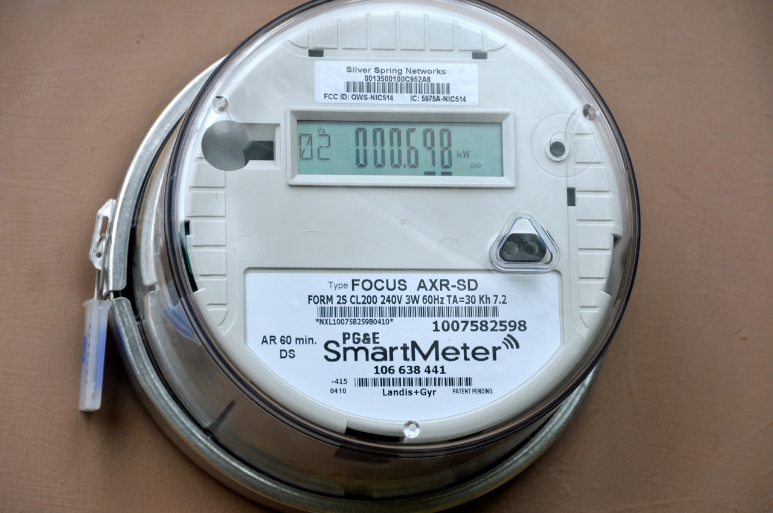
How does it looks

Slide 6
How smart meter works..
Smart meters use a secure national communication network (called the DCC) to automatically and wirelessly send your actual energy usage to your supplier. This means households will no longer rely on estimated energy bills or have to provide their own regular readings.
Smart meters will also come with an in-home display. This display gives the household real-time usage info, including kWh use and cost.

Slide 7
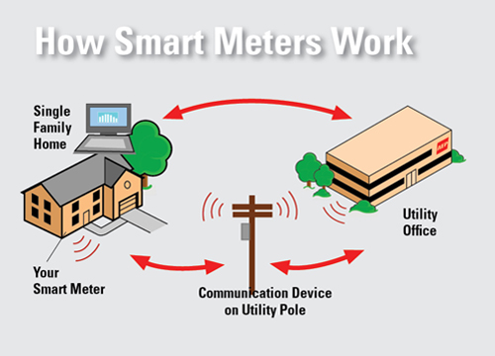

Slide 8
what are the benefits of using smart meter..?
FOR CONSUMERS.. Consumers can be informed remotely (historical data) or locally (real-time data) on energy costs and carbon emissions Energy consumption of household gas, electrical and water equipment can be displayed on the appliance or on displays multi tariff functions can be added to allow demand response techniques Allows electrical appliances to be automatically controlled Allows the consumer to reduce costs by increasing energy consumption during off-peak cheaper tariff periods.

Slide 9
FOR UTILITIES..
Gainfirst-class data
Influence the energy consumption of their users
Improve profitability of the technology once Smart Metering is also used for gas, water and heat readings.
A reduction in ‘costs to serve’
Open gateways for the delivery of energy services
Assistance in the development of liberalised energy market
Help for revenue protection
Monitoring of the generation from building renewables
Support in demand response techniques
More effective grid management
A new communication channel to customers.

Slide 10
FOR NATIONAL GOVERNMENTS..
Smart Metering will:
Prove to be THE tool to entice consumers to manage their consumption better and reduce usage leading the way to improved service levels through richer billing information
Be a key weapon in the fight on climate change
Help governments implement liberalisation of energy markets
Allow the full realisation of the Energy Services Directive

Slide 11
FUTURE CAPABILITIES
Smart Meters will transport us into a new era of energy delivery and enhanced customer service, including the ability to support:
Expanded product options - Your Retail Electric Provider (REP) may offer new, innovative price plans such as time-of-use rates and pre-paid metering.
Home Area Network (HAN) - Over time, you'll be able to remotely control 'smart' appliances like your thermostat at your home or business through the Internet.
In-home monitors - These devices that may be sold at retailers or through your REP, will provide you with immediate feedback from your Smart Meter and REP, including your current and past electricity information.

Slide 12
Role of machine learning…
Machine learning is a type of artificial intelligence (AI) that allows software applications to become more accurate in predicting outcomes without being explicitly programmed.
The basic premise of machine learning is to build algorithms that can receive input data and use statistical analysis to predict an output value within an acceptable range.

Slide 13
Forecasting electricity usage is an important task to provide intelligence to the smart gird.
Accurate forecasting will enable a utility provider to plan the resources and also to take control actions to balance the electricity supply and demand.
The customers will benefit from metering solutions through greater understanding of their own energy consumption and future projections, allowing them to better manage costs of their usage

Slide 14
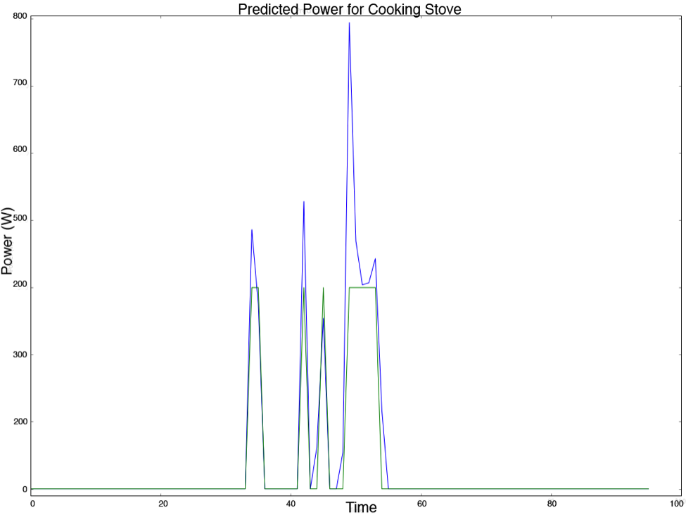
The Blue line shows the amount of power used by a stove over the course of a day,
And the Green line shows the amount of power predicted by the model. As you can see the pattern is detected reasonably well, though the scale is not perfect
Blue line
Green line

Slide 15
REFERENCES….
esmig.eu/page/smart-metering-technologies

Slide 16


Slide 17


